Slide 1
Psychology 1A – PSY1011
Semester 1, 2012
Week 2: History of Psychology
History of Psychology
Dr Wendy McKenzie wendy.mckenzie@monash.edu.au

Slide 2
“You can’t know where you are going until you know where you have been”
An understanding of history gives us:
Greater perspective and a deeper understanding
Recognition of fads and fashions
Ability to avoid repetition of mistakes
A source of valuable ideas
    (Hergenhahn, 2005)

Slide 3



Week 2: Preparation
Learning objectives / keywords
Study plan
Reading

Slide 4
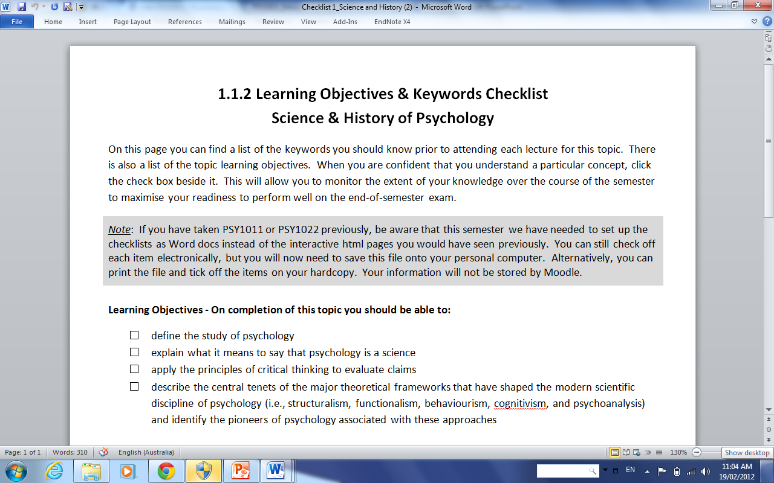

Slide 5
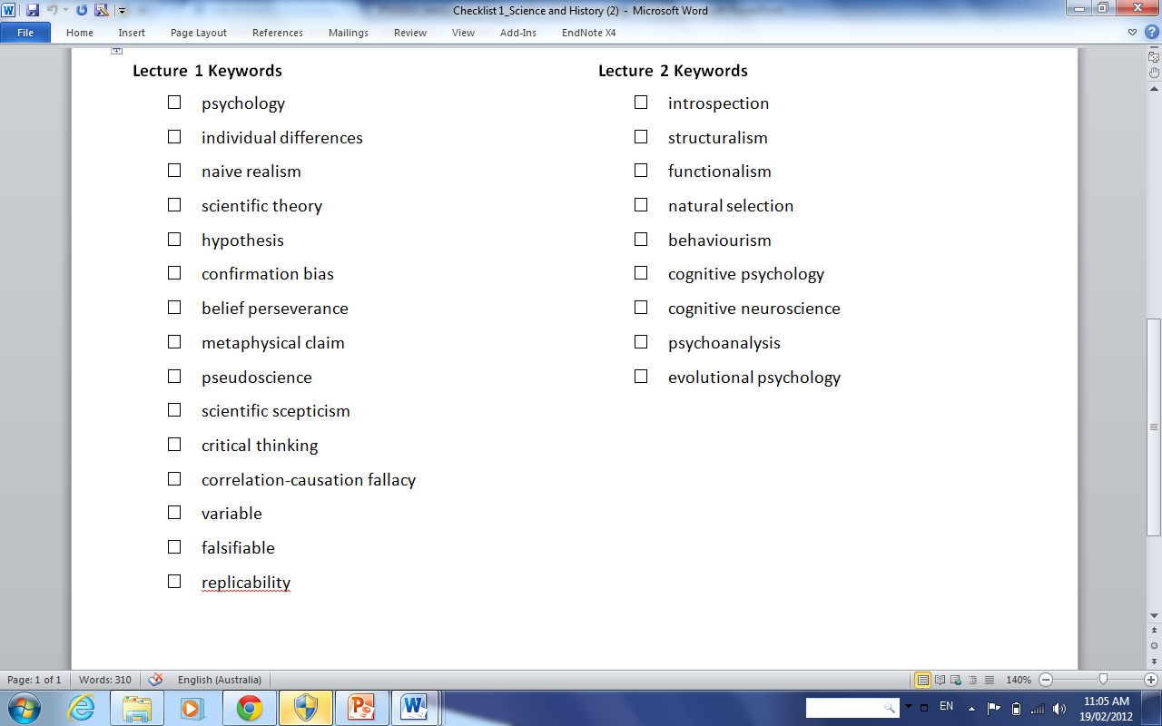

Slide 6

“Psychology has a long past,
but only a short history”
Hermann Ebbinghaus (1910, cited in Thorne & Henley, 1997, p. 8)

Slide 7
Where do we start?
‘Birth’ of psychology in 1879
  Wundt established the first psychology laboratory
Most argue we need to go further back to the ideas of the early philosophers
Also need to consider how contributions in other areas of science have influenced psychology
  e.g., physiology, medicine, biology, physics, computer science

Slide 8
Psychology education
Boulder Conference on Graduate Education in Clinical Psychology (1949)
Scientist – Practitioner model

Slide 9
Lecture structured around 3 themes:
Precursors to the birth of psychology
  Philosophy
  Medicine
The birth and rise of modern psychology
New perspectives from clinical practice

Slide 10
Before Psychology
Experimental Psychology
Clinical perspectives

Slide 11
Why Philosophy?
Psychology grew out of philosophy
Persistent questions:
  The mind-body problem
  The origins of human knowledge
  Nature vs. nurture
  Relationship between humans and non-human animals

Slide 12
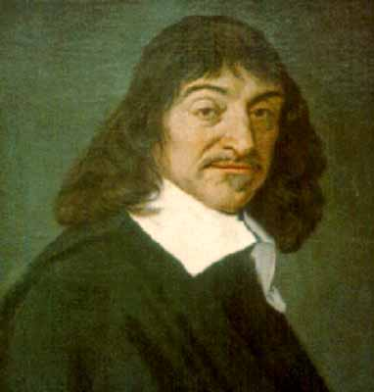
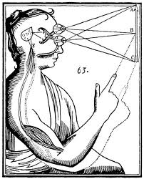
Early Modern Philosophy
Rene Descartes (1596-1650)
French mathematician,
physiologist, philosopher
Challenged dogma by resolving to doubt everything
“Cogito ergo sum” or “I think, therefore I am”
Mind-body dualism

Slide 13
British empiricism
Rejected rationalist doctrine of innate ideas (Descartes)
All knowledge is derived from experience, mainly sensory experience

Slide 14
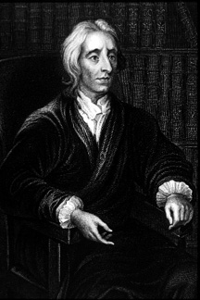
John Locke (1632-1702)
The human mind begins as
a “tabula rasa” and we
learn through experience
Two sources of ideas from experience:
1. Sensation and 2. Reflection

Slide 15
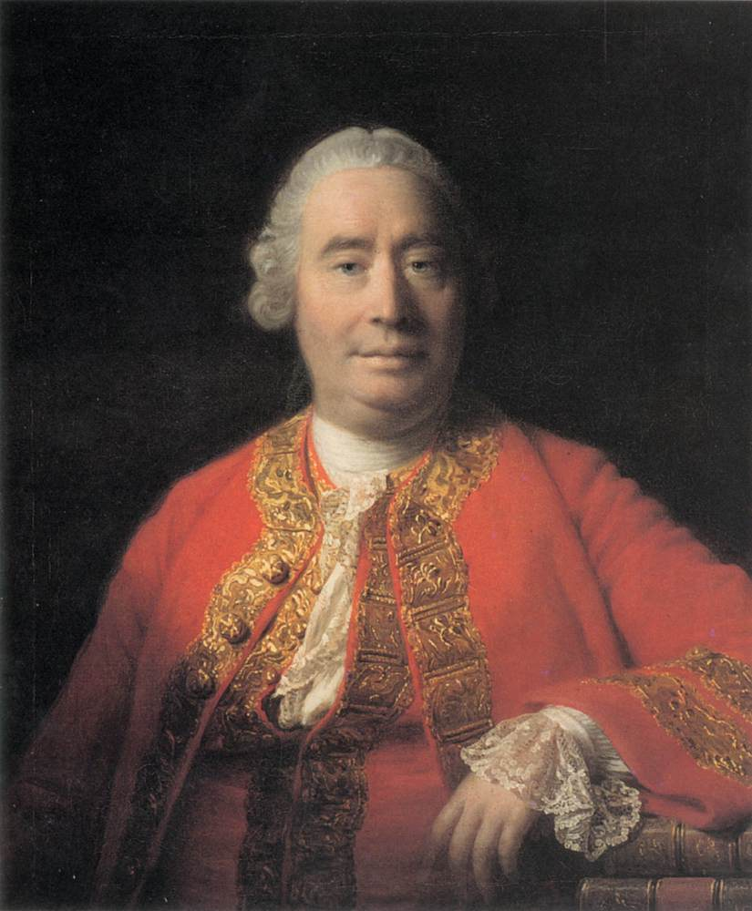
David Hume (1711-1776)
Organization of ideas according to laws of association:
  Law of resemblance (similarity)
  Law of contiguity (same time and place)
  Law of cause and effect (form a connection as ‘habit’ of mind built up over time)

Slide 16
Empiricism vs. Rationalism
Rationalists (like Descartes) contend the way to knowledge is only through reason and thought; mind actively transforms sensory information
Empiricists (like Locke) argue all knowledge is gained through experience; with emphasis on the method of using observation and sensory impressions to build knowledge
  Laws of association

Slide 17
Both rationalist and empirical approaches have their place. . .
The type of work favoured by empiricists is empirical work. By definition, an empirical project is one that requires observation at some point. The type of work favored by rationalists is theoretical work, a theoretical project being defined as one that does not require observation at any stage (Kukla, 2001, pp. 1-2).

Slide 18
19th century developments in physiology / medicine
‘de-mystification’ of the nervous system
  Nerve function
    Muller, Helmholtz
  Localisation of function
    Gall, Flourens, Broca

Slide 19
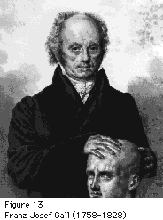
These bumps on the surface of the head correspond with underlying brain functions
PSY1011 History 2007 WMcK Lecture 2

Slide 20
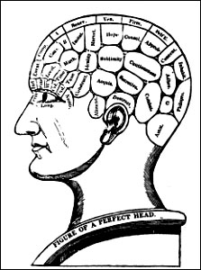
Franz Joseph Gall (1758-1828)
(Germany)
Gall’s Phrenology or Cranioscopy – became fashionable
Underlying assumptions:
  Indentations and bumps on the outer contours of skull reflect contours of brain;
  Brain can be divided into small number of functions
  Mind’s functions located in specific areas of the brain

Slide 21
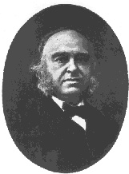
Paul Broca (1824-1880)
(France)
Published clinical evidence:
injuries to specific areas in
left cortical hemisphere
of brain lead to specific
loss of speech production—
known as Broca’s area
Later Wernicke’s area shown to be associated with deficits in speech comprehension
Supported the localisation of function position

Slide 22
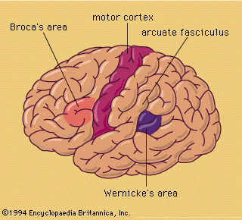
Broca’s area: damage to the left inferior frontal lobe = impairment of speech output
Wernicke’s area: damage to left hemisphere temporal lobe = impairment in speech comprehension

Slide 23
The beginnings of psychological measurement: Psychophysics
Weber (1795 – 1878; Germany)
Used the two-point threshold method to show sensitivity to touch differed across different body areas
Used increases in weights to determine Just Noticeable Differences (JNDs); demonstrated judgements are relative

Slide 24
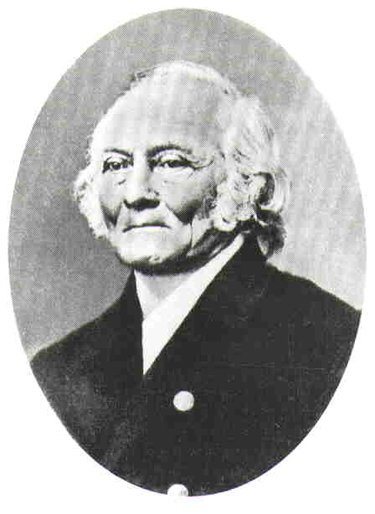
Gustav Theodor Fechner (1801-1887) (Germany)
Fechner’s law: S = k log R
  S = psychological sensation
  k = constant
  log R = log of the physical stimulus intensity
“Elements of Psychophysics” influenced early psychologists such as Wundt and Ebbinghaus

Slide 25
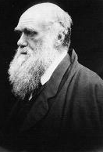
Theory of Evolution
Charles Darwin (1809-1882)
Humans have descended from animals by modification through principles of natural selection
Change in religious and Cartesian thinking: no separation between man and animals
Examination of emotions in humans and animals; observed universality of emotional expressions

Slide 26
Impact of Evolutionary Theory
Study of animal behaviour as model for human behaviour—influence on behaviourism
Stimulated an interest in the measurement of individual differences
Precursor to the school of functionalism
Contemporary views on evolutionary psychology

Slide 27
The birth of psychology
Emergence ofexperimental psychology
Structuralism
Functionalism
Early Behaviourism
Cognitivism
Neobehaviourism
Cognitivism

Slide 28
Summary: Organize your understanding
Schools | People | Goal | Methods/ key concepts | Influences
Structuralism
Functionalism
Behaviourism
Cognitivism

Slide 29
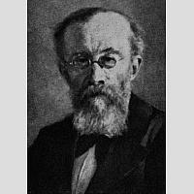
Wilhelm Wundt (1832-1920)
(Germany)
Seen as the founder of
experimental psychology
Began the first journal of Psychology: Philosophical Studies (1881).
Opened up first university based lab of psychology at University of Leipzig (1879)

Slide 30
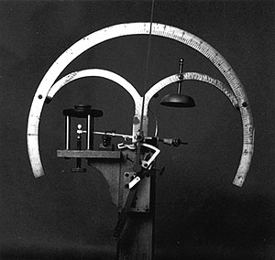
Contribution of Wilhelm Wundt
Goal of Wundt’s research was to understand consciousness
He confined experiments to immediate experience
Claimed that “the events of mental life are known through introspection”
attempted to use introspection scientifically
http://www.youtube.com/watch?v=Zr7O41r8uEI
sought to investigate the immediate experiences
of consciousness, including sensations, feelings,
volitions, apperception, and ideas.

Slide 31
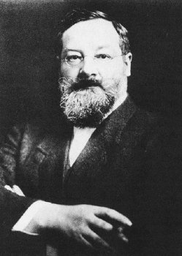
Edward Titchener (1867-1927)
Student of Wundt
Englishman who completed PhD
at Leipzig
Moved to US to head new Dept
of Psych at Cornell University
Goal (like Wundt): to learn about
the structure of the mind through
analysing elementary conscious
experience
Structuralism

Slide 32
Titchener’s Structuralism
Adapted Wundt’s methods, using “analytical introspection” to study the structures of the mind
Elements of consciousness: sensation, images and affections (feelings) can be known by listing attributes
Decline of structuralism partly due to criticisms of introspection as an experimental method

Slide 33
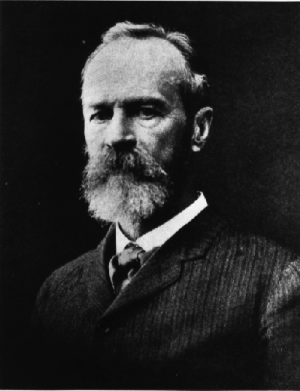
William James (1842-1910)
Opened small psychology lab at Harvard, but not a research scientist
Functionalism: “What for” (i.e. function) of mind, NOT “What is” (i.e. structures)
Consciousness evolved because it has a function—to help us in the struggle for survival
‘Principles of Psychology’ 1890
AIM: To examine the purpose and functions
of the mind
Influenced by Darwin: behaviour
can be understood in terms of its purpose
without analysing its mechanisms
Functionalism

Slide 34
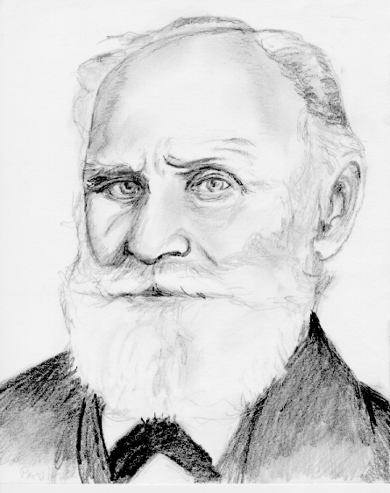
Ivan Pavlov (1849-1936)
Pavlov influenced by Russian physiologist Sechenov who had worked with Wundt
Studied function of conditioned reflexes
Lead to the development of a theory of learning known as classical conditioning
Classic example of pairing a bell (CS) and meat (UCS) to produce the conditioned response salivation

Slide 35
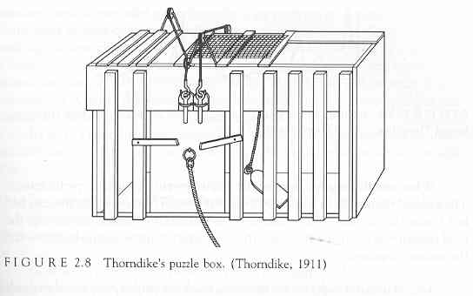
Edward Lee Thorndike (1874-1949)
Performed systematic experiments on the learning process (Columbia University, USA)
Studied S-R connections by observing the learned behaviour of cats in puzzle boxes
Law of Effect

Slide 36
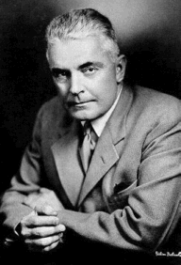
Behaviourism
John B. Watson (1878-1958)
Behaviourist Manifesto (1913):
* The rejection of introspection
* Emphasis on objectivity
* Prediction and control
* Use of animals

Slide 37
Watson’s behaviourism
Described relationship between environment (stimulus) and behaviour (response)
Made claims about the importance of education over inherited characteristics and instincts
Study of Little Albert and the white rat demonstrated the view of phobias as conditioned fear responses

Slide 38
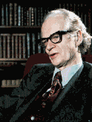
B.F. Skinner (1904-1990)
Return to radical behaviourism
Skinner similarly emphasised
observation and control
Also argued that psychological
studies should only focus on
objective and measurable phenomena
Skinnerian Behaviourism:
All behaviour is determined by its consequences

Slide 39
The birth of psychology
Emergence of experimental psychology
Wundt (1879) founded psychology
Structuralism
Titchener
Functionalism
James
Experimental work
Pavlov, Thorndike
Early Behaviourism
Watson
Behaviourism
Skinner

Slide 40
Origins of experimental psychology: Summary
The zeitgeist led to the emergence of experimental psychology
Structuralism contrasted with functionalism
Pavlov’s and Thorndike’s work on learning coincided with the beginnings of behaviourism as introduced by Watson
Skinner’s radical behaviourism emerged

Slide 41
The rise of modern cognitive psychology
Decline of Behaviourism
Skinner
Neobehaviourism
Gestalt psychology
Wertheimer, Kohler, Koffka
Developmentalists
Piaget, Vygotsky
Emergence of
mentalist
psychology
Chomsky,
Information processing era
Computational approach
Connectionism (neural networks)

Slide 42
Behavourism vs. Cognitivism
Adapted from Lieberman, D. (2004). Learning and Memory: An integrated approach. Belmont, CA: Wadsworth/Thomson Learning. Figure 1.3
Behaviourism
Mental states
Environmental
conditions
Behaviour
Cognitive psychology

Slide 43
The decline of behaviourism
Psychologists increasingly challenged the view that cognitive events do not exist
Neobehaviourism: Accept theoretical speculation about the existence of mediational variables (internal mental states), provided theoretical terms are operationally defined and lead to testable predictions
E.g., Clark Hull (1884-1952): ‘drive’
Edward Tolman (1886-1958): ‘cognitive maps’

Slide 44
Gestalt Psychology
1910: Max Wertheimer observed a perceptual effect named the phi phenomenon
http://www2.psych.purdue.edu/Magniphi/SimpliPhi.html
Contradicts Wundt and Titchener’s molecular approach, the goal of which was to uncover the elements of consciousness
Gestalt psychology focuses on ‘wholes’ not parts or elements of experience, the “whole is more than the sum of the parts”

Slide 45
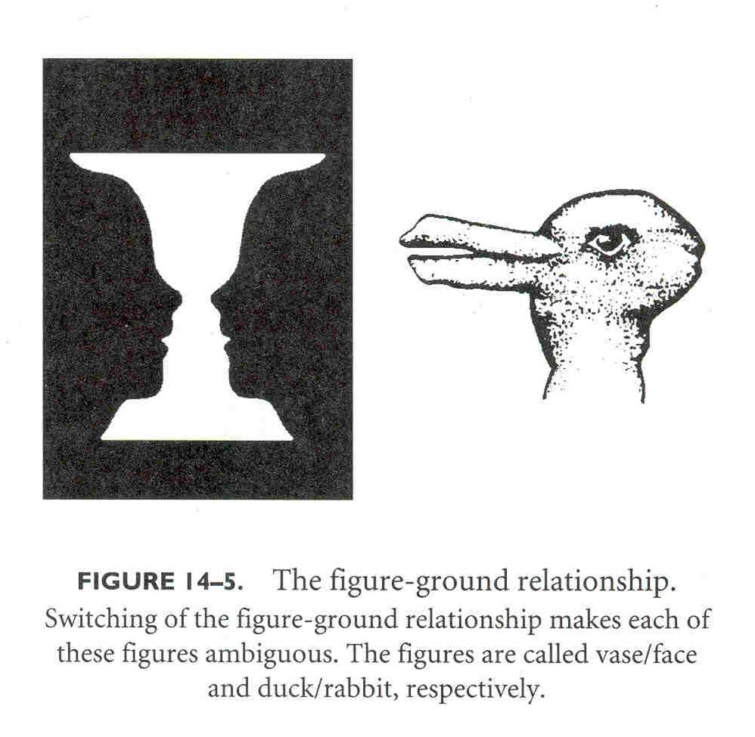
Figure from Thorne, B. M. & Henley, T. B. (1997). Connections in the History and Systems of Psychology, Boston: Houghton Mifflin Company p. 381

Slide 46
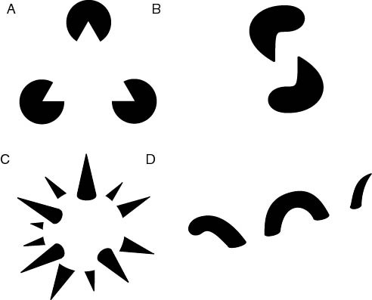
Image from http://en.wikipedia.org/wiki/Image:Reification.jpg

Slide 47
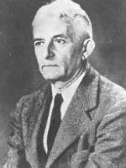
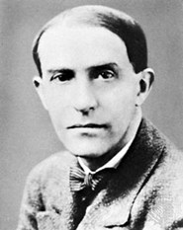
Gestalt psychology
Interested in how we organise our perception of the world – as humans we tend to “fill in the blanks
Köhler emphasised a “top-down” approach which aims to achieve closure and completion
  Principles of organization
  Figure / ground distinction
Insight learning in chimpanzees
Köhler
1887 – 1967
Koffka
1886 – 1941

Slide 48
Forerunners to the cognitive revolution
Experimental studies of cognitive abilities:
Sir Frederic Bartlett (1932) describes the role of schemas in “reconstructive memory”
Miller’s (1956) demonstrates the limited capacity of short-term memory as the magical number 7 (± 2)

Slide 49
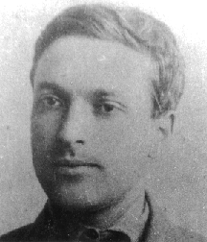
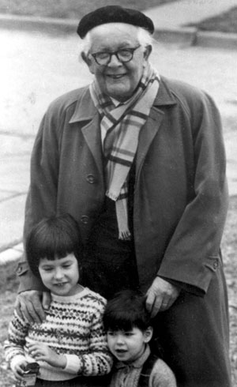
Forerunners to the cognitive revolution
Lev Vygotsky described the development of self in conversational practices
  “Thought and language” banned until 1956, published in English 1962
Jean Piaget examined cognitive development
  “Psychology of Intelligence” translated into English 1950
Vygotsky (1896-1934)
Piaget (1896-1980)

Slide 50
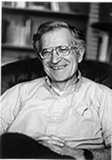
Further challenges to behaviourism
Noam Chomsky’s (1959) review of Skinner’s Verbal Learning argued that Behaviourism cannot explain language learning
His approach has been described as Cartesian and Rationalist
Suggested that we are preprogrammed to learn grammatical rules
Chomsky
(1928 - )

Slide 51
The cognitive revolution – 1960s
The focus is on internal representations of the external world
View of human beings as active, information processors
  Computational models: Thought or cognition IS the computer-like processing of information and symbols in rule governed ways
  Connectionism (neural networks) – 1980s:
    ‘neurally inspired’
    parallel processing

Slide 52
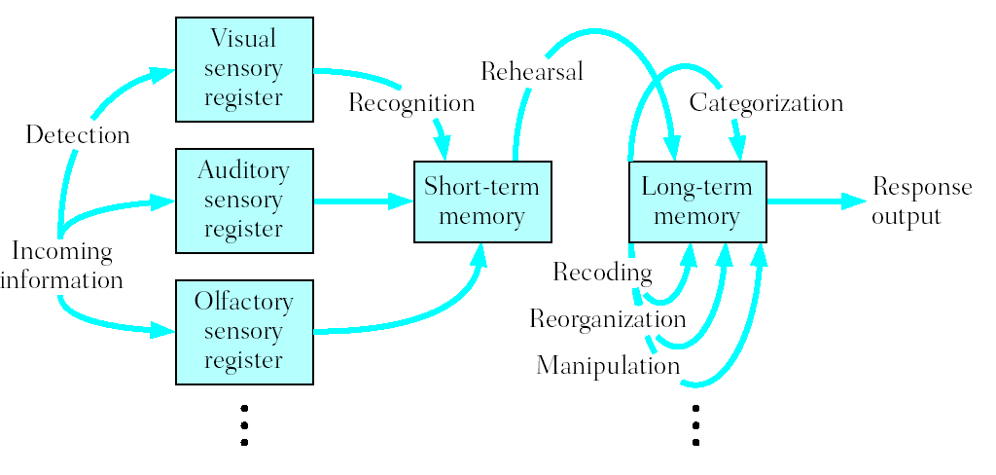
A typical information processing model
(Figure 1.4, p. 29) Galotti, K.M. (2004). Cognitive Psychology In and Out of the Laboratory (3rd ed.), Belmont, CA: Thomson/Wadsworth.

Slide 53
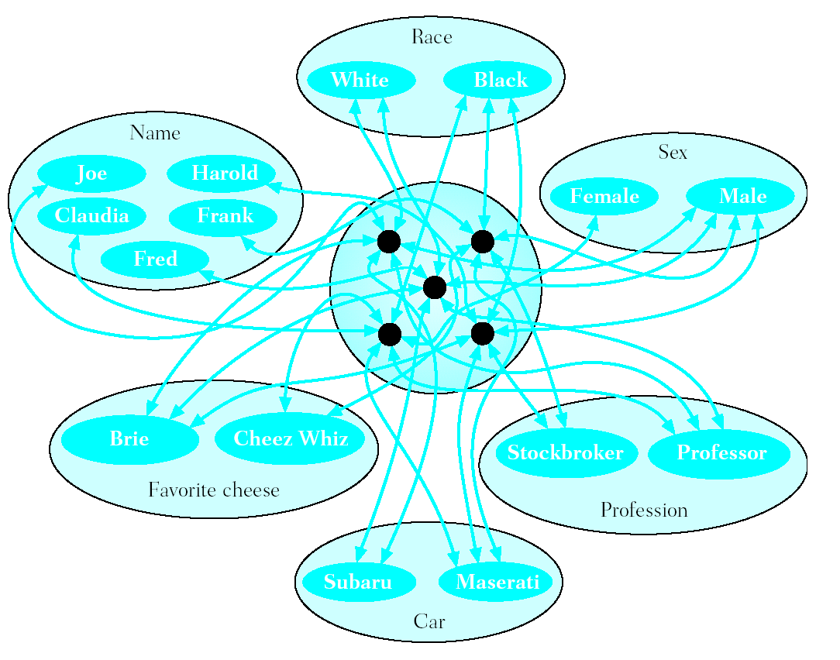
A typical connectionist model
(Figure 1.5, p. 31) Galotti, K.M. (2004). Cognitive Psychology In and Out of the Laboratory (3rd ed.), Belmont, CA: Thomson/Wadsworth.

Slide 54
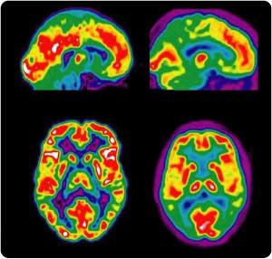
Cognitive Psychology
  how people learn, store, use information
Cognitive Neuroscience
  neural bases of cognition
Cognitive Science
  study of the mind / interdisciplinary
  view that science and philosophy can be combined
http://www.elements4health.com/pet-scans-reveal-plaques-and-tangles-in-alzheimers.html

Slide 55
The rise of modern cognitive psychology: Summary
Greater acceptance that cognitive events exist contributed to the decline of behaviourism
Experimental studies on cognitive abilities encouraged the emergence of mentalist psychology
Chomsky challenged the behaviourist interpretation of language learning
The cognitive revolution in the 1960s seen as the beginning of the information processing era

Slide 56
Summary: Organize your understanding
Schools | People | Goal | Methods/ key concepts | Influences
Structuralism
Functionalism
Behaviourism
Cognitivism

Slide 57
New perspectives from clinical practice
Early clinical work
Mesmer, Charcot,
Janet’s influence
Psychoanalysis
Freud, Jung
Behaviour therapy
Skinner
Humanistic psychology
Rogers
Cognitive therapy
Beck

Slide 58
Early treatment of the mentally ill
Possession by demons
  Exorcision (e.g., trephining)
  Witchhunts
Early asylums still inhumane treatment (e.g., St. Mary of Bethelem or ‘Bedlam’ in London)
Improvement in treatment in 18th century (e.g., Pinel)
Changing views of basis for mental illness

Slide 59
Precursors to Freud
Mesmerism
  Franz Anton Mesmer (1734-1815)
  Viennese physician who developed a method of treatment using magnets
Hypnotism
  James Braid (1795-1860) “neuro-hypnology”
  Ability to be mesmerised lay with the subject
Jean-Martin Charcot (1825-1893)
  Study of hysteria as a disorder with a psychological basis
  Use of hypnosis as treatment
Pierre Janet (1868-1847)
  Trauma produces hysteria, unpleasant memories “split off” from conscious and manifest as hysteric symptoms
  Use hypnosis to bring dissociated memories to consciousness

Slide 60
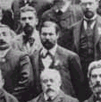
Sigmund Freud (1856-1939)
Founder of psychoanalysis:
  Emphasizes the role of unconscious processes
[Original lectures and writings can be found at http://psychclassics.yorku.ca/]

Slide 61
Development of Freud’s ideas
Treatment of hysteria using hypnosis
Replaced by the method of free association developed in 1892
Studies on Hysteria (1895) – Breuer and Freud
  Hysteria caused by trauma that has been repressed and manifest in physical symptoms, need to make conscious to treat
  Cathartic method (‘talking cure’)
Seduction theory of hysteria (1896): neuroses are the result of sexual abuse in childhood

Slide 62
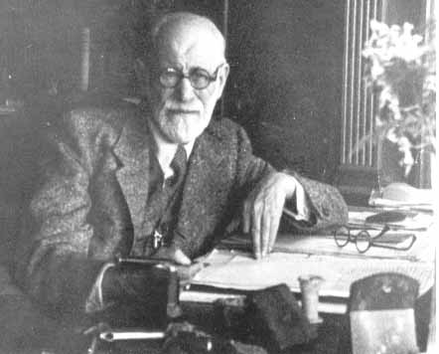
Freud (cont’d)
Self-analysis of Freud’s own dreams contributed to the publication of The Interpretation of Dreams (1900)
Theory of personality
  Id – pleasure principle
  Ego – reality principle
  Superego – morality
Psychosexual stages of development

Slide 63
Beyond Freud
Some criticisms of Freud’s work:
  Lack of falsifiability
  Dogmatic, non-experimental approach
  Definition of terms
  Too much emphasis on sex as motivation
Neo-Freudians: New Directions
  Anna Freud and Melanie Klein applied psychoanalysis to children
  Development of attachment theory (Bowlby & Ainsworth)
  Karen Horney - emphasized cultural influences

Slide 64
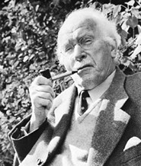
Carl Jung (1875-1961)
Disagreed with Freud’s emphasis on sexual motivation
Collective unconscious: repository for the experience of humanity
  Archetypes: inherited predisposition
    E.g., Anima (female); Animus (male)
Introversion vs. Extroversion

Slide 65
The behaviourist challenge
Opposed to psychoanalysis
Both comprehensive systems
Examine environment rather than explore the past
Development of treatment techniques
Behaviourism based on experiments

Slide 66
Humanistic alternatives
‘third force’ or humanistic psychology
  an alternative to behaviourism and psychoanalysis
Emphasis on human beings as unique individuals
Focus on the positive, not the negative
Assumes humans are free to choose (not determinism)

Slide 67
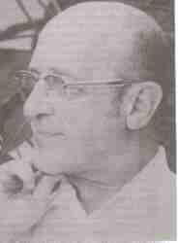
Carl Rogers (1902-1987)
Human beings driven by a need for self-actualization
Goal of therapy is to foster an individual’s potential for growth
Client or person-centered therapy
  Unconditional positive regard
  Empathic understanding
  Congruence
Encouraged research by recording therapy sessions

Slide 68
The Patient … through the ages
Marcie has just started college. She grew up in a small town but enrolled in a major city university far from home. Her family has few financial resources, and the university scholarship was her only opportunity for a university education. She was reluctant to leave home, but her family and teachers encouraged her because it was a tremendous opportunity. When Marcie was a child, she went to camp one summer and was very homesick for an entire week. Now Marcie is having those same feelings again as she tries to adjust to university life in a new city. She is very sad, cries for no reason, and has stopped attending classes. She believes she is a failure for being unable to adjust and is afraid to tell her parents how she feels. She barely talks to her housemate, who is very concerned about the change in her behaviour. Marcie no longer takes a shower, sometimes does not get out of bed, and will go for several days without eating.

Slide 69
New perspectives from clinical practice: Summary
Early approaches based on hypnosis, trauma and hysteria
Emerging psychological focus
Psychoanalytic ‘talking cure’ dominates
Behaviourist rival emerges
Humanistic approach as the ‘third force’
Eclectic approaches emerge, integration and re-invention

Slide 70
Week 3: Learning lecture topic 1
Check objectives & keywords – Moodle
Complete the Week 3 Study Plan in
before the lecture (please!)

